Slide 1
The effects of light exposure on plant morphology
Matthew Willson
Florida State University, Tropical Behavioral Ecology 2019

Slide 2


Plants need light for photosynthesis
Wavebreakmedia Ltd/Wavebreak Media/Getty Images
https://www.thegreenage.co.uk/tech/artificial-photosynthesis/
Notes:
Light is a requirement for photosynthesis and most plants obtain light through their leaves. The total leaf area or the product of the number of leaves and leaf area of a plant can be important for its growth and success.

Slide 3
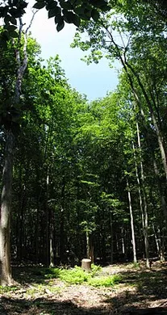
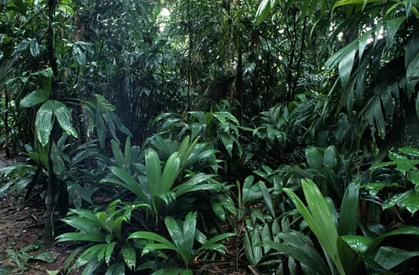
Differences in gaps and understory that lead you to expect differences in plant morphology
Gap
Understory
https://upload.wikimedia.org/wikipedia/commons/thumb/1/13/Treefall_gap_in_Institute_Woods.jpg/220px-Treefall_gap_in_Institute_Woods.jpg
http://wikis.wheatonma.edu/rainforest/index.php?title=File:Understory_Palms_1.jpg

Slide 4
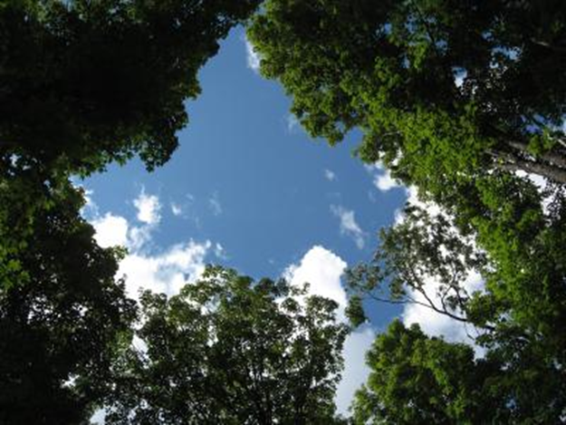
Question: How does light exposure from tree gaps affect plant morphology?
https://phys.org/news/2011-05-trade-offs-deer-timber.html

Slide 5
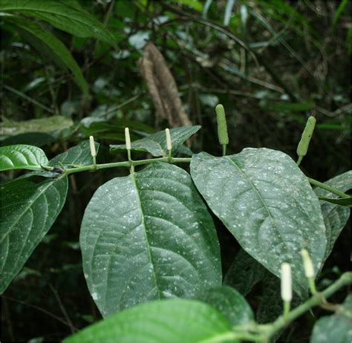

Study site and focal organism
Isla Boca Brava, Panama
Piper sp.
http://www.quazoo.com/q/piper_hydrolapathum
https://www.dominicalrealty.com/property/660/

Slide 6

H1: Plants in the understory will have higher light-gathering power

Slide 7

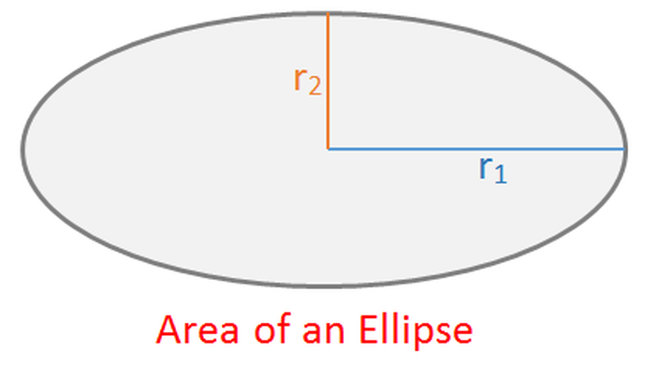
Data Collection
Leaf area
Number of leaves
Number of stems
Plant height
A = π x r₁ x r₂
http://calculator.swiftutors.com/area-of-an-ellipse-calculator.html

Slide 8
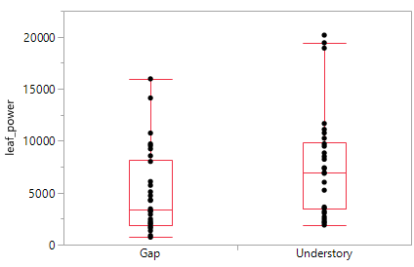
Plants in the understory have higher light-gathering power
Leaf power
(avg. area x number of leaves)
Gap
Understory
N = 30 plant individuals
N = 30 plant individuals
Wilcoxon Rank Sums Test: Z = 2.41725, p-value = 0.0156

Slide 9
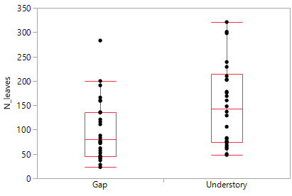
Number of Leaves vs Site Type
N_leaves
Gap
Understory
N = 30 plants
N = 30 plants
Wilcoxon Rank Sums Test: Z = 2.66, p = 0.008

Slide 10
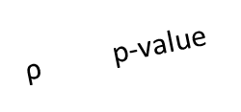
Plants in the understory have higher light-gathering power: Other factors associated with leaf number
ρ p-value
Number of stems
N = 60 plants
Number of leaves
N = 60 plants
Plant Height
Non-parametric Spearman’s Test
Notes:
But there was not a significant different in plant size and number of stems between gaps and understory.

Slide 11
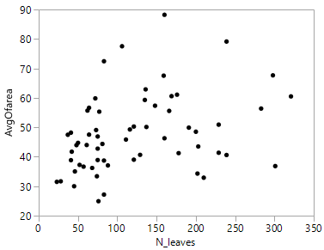
H2 – Tradeoffs in leaf area and N leaves
Plants with more leaves also had larger leaves
Avg_leaf_area
N_leaves
N = 60 plants
Spearman’s rho = 0.36, p = 0.004

Slide 12
Summary
Differences in leaf power between gaps and understory
Number of leaves was driving plant leaf power
No tradeoffs in leaf area and number of leaves

Slide 13

Acknowledgments
Kevin Dixon
Emily Duval

Slide 14

Questions?
https://pixabay.com/illustrations/question-mark-note-duplicate-2110767/

